Slide 1
DR Kottnis Hospital
Muhammad Ahsan Ali 233569
Muhammad Jawad 233557

Slide 2
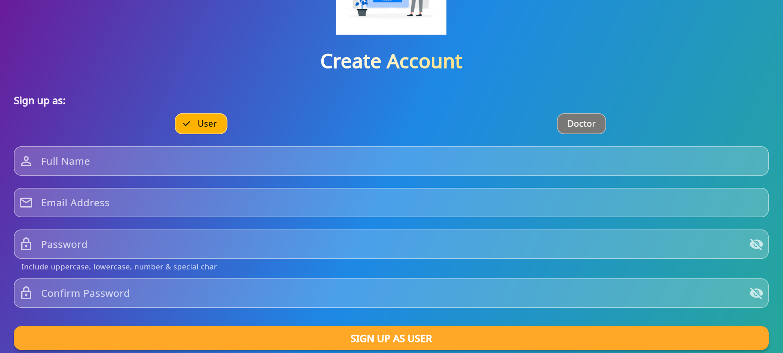
Register as a user

Slide 3
Register as a user

Slide 4
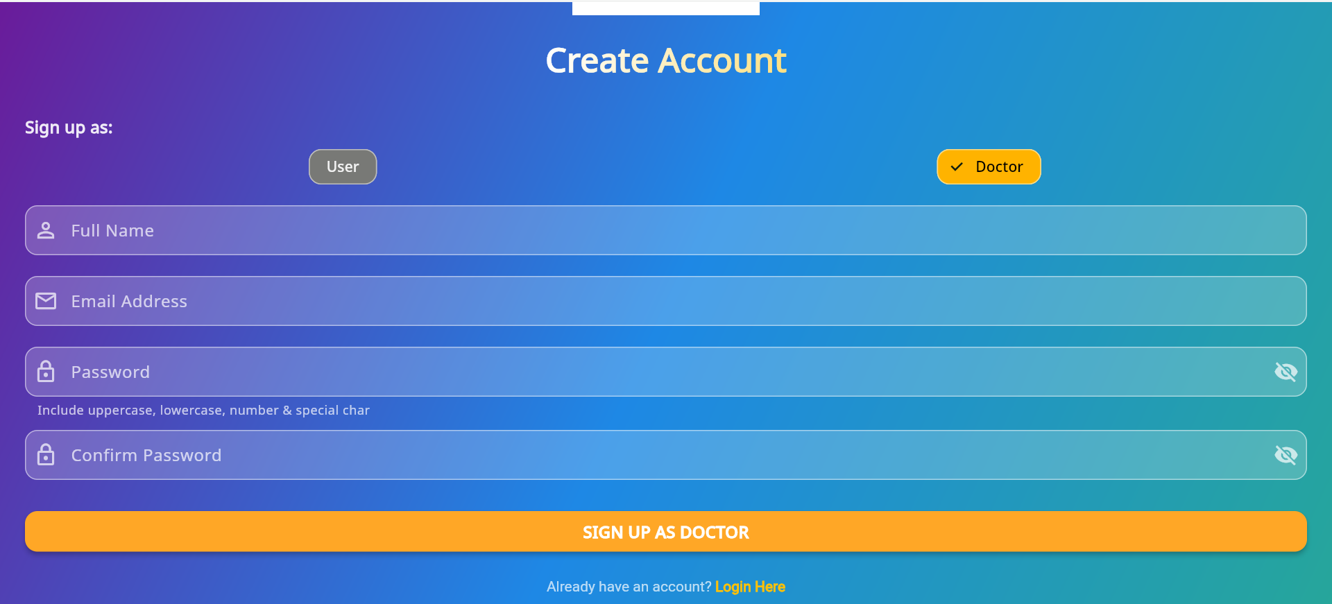
Register as a Doctor

Slide 5
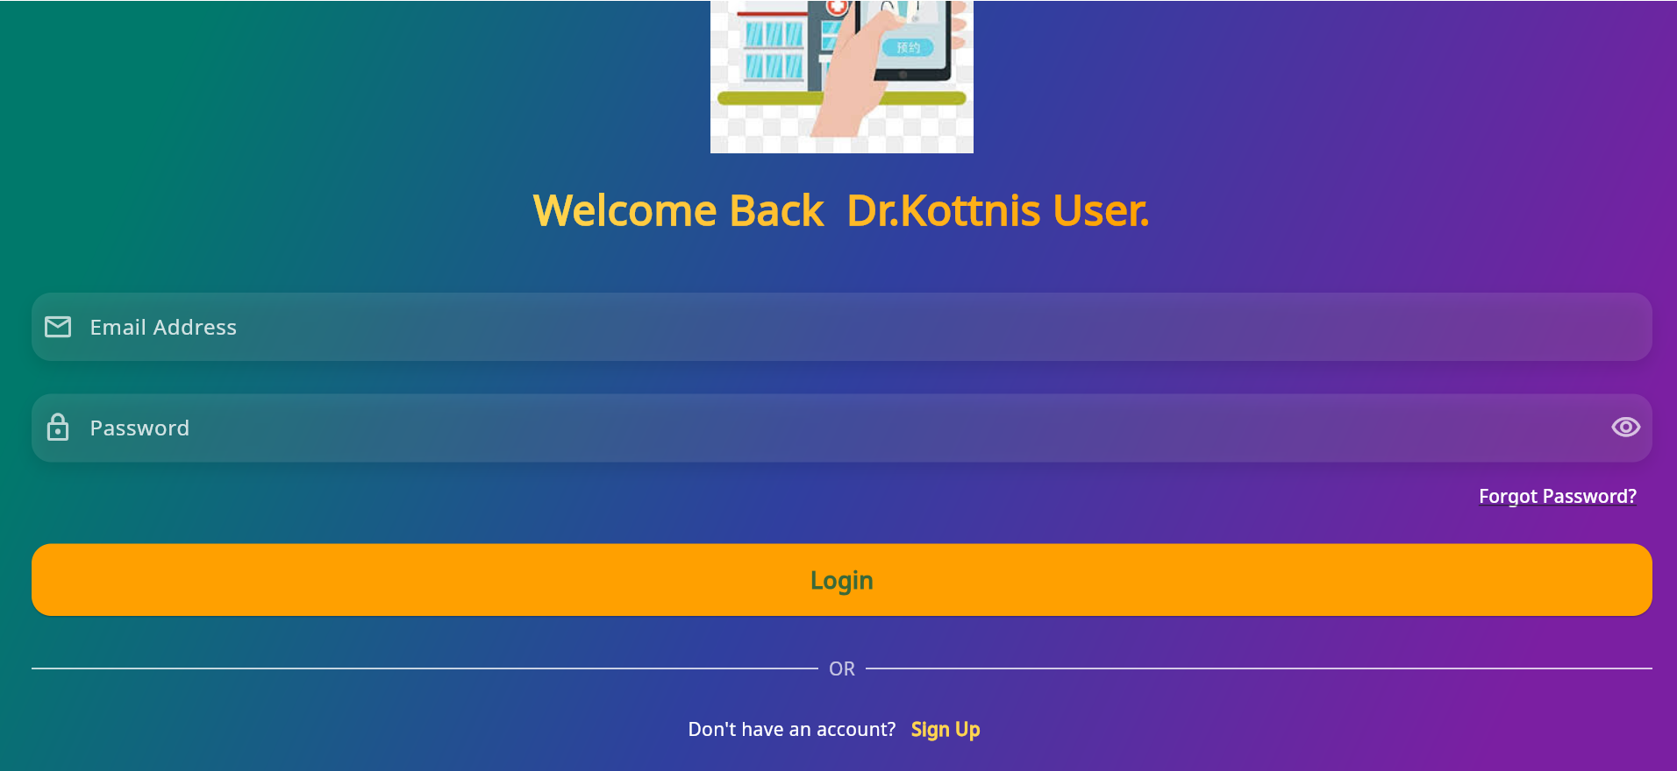
Login page

Slide 6
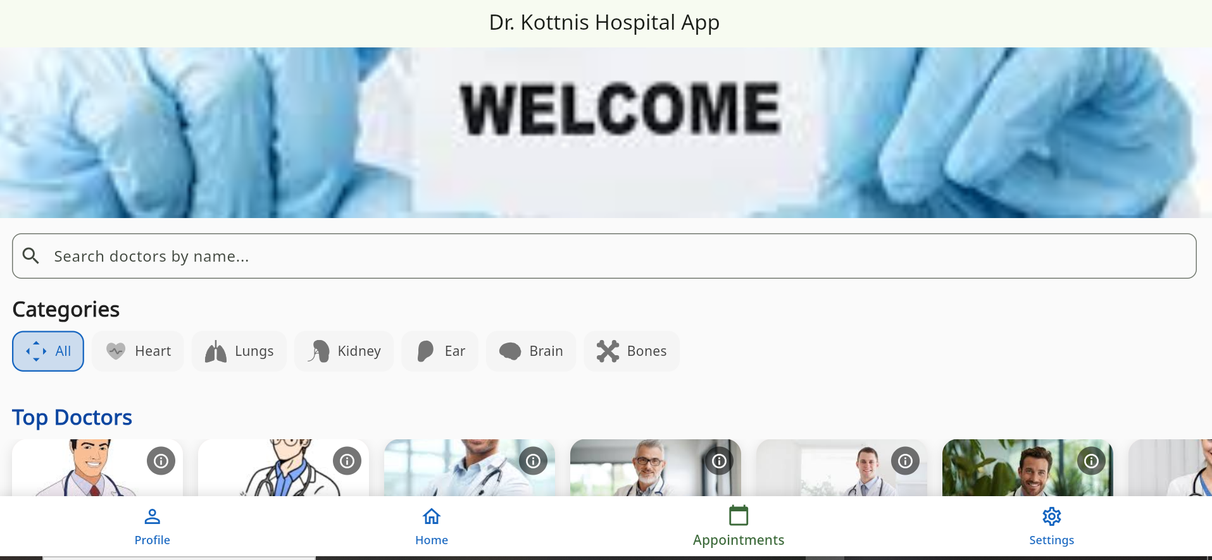
Home Screen

Slide 7
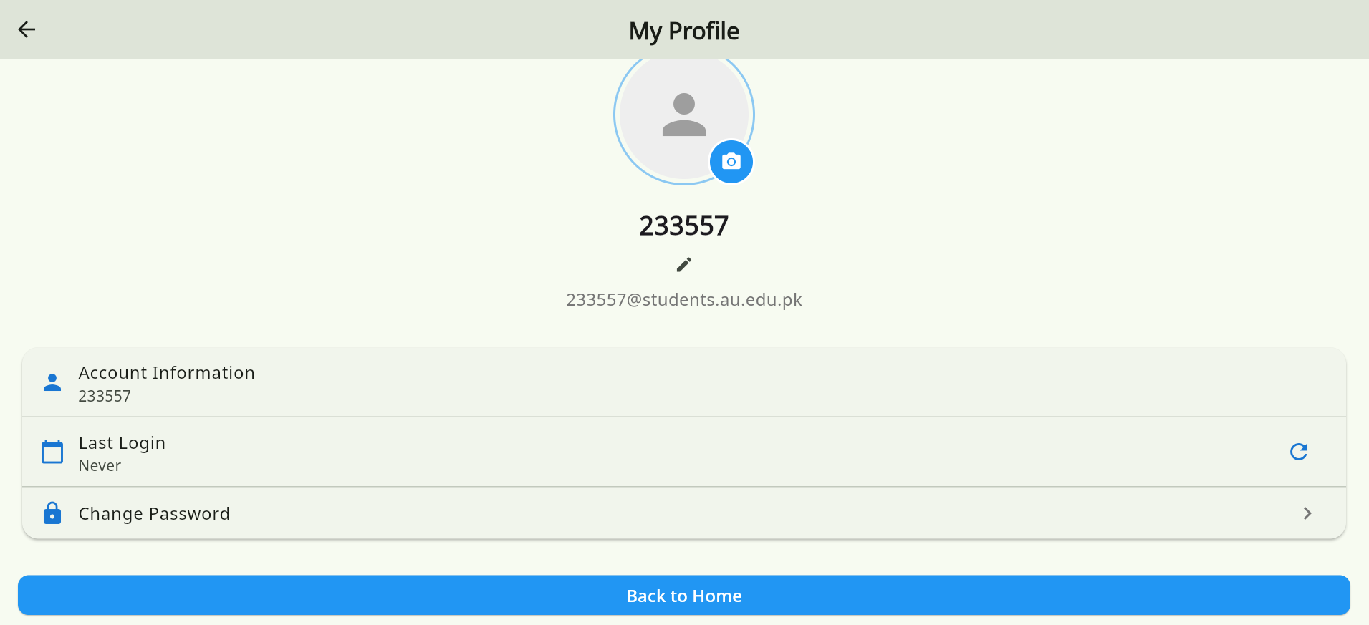
User Profile

Slide 8
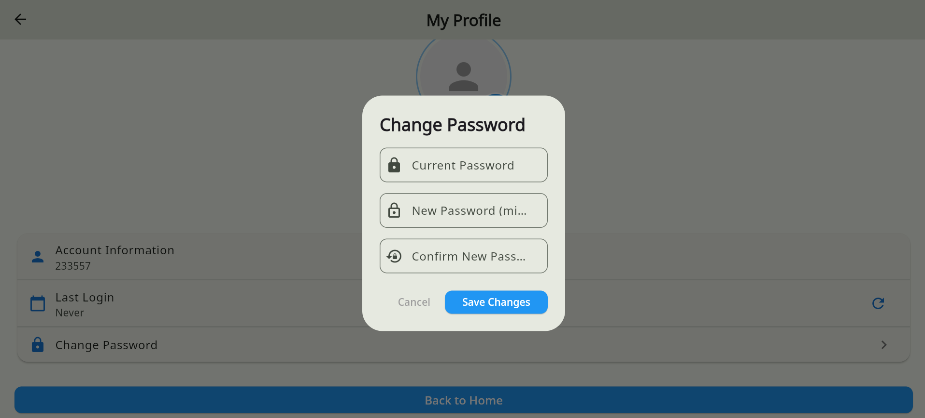
Change password

Slide 9
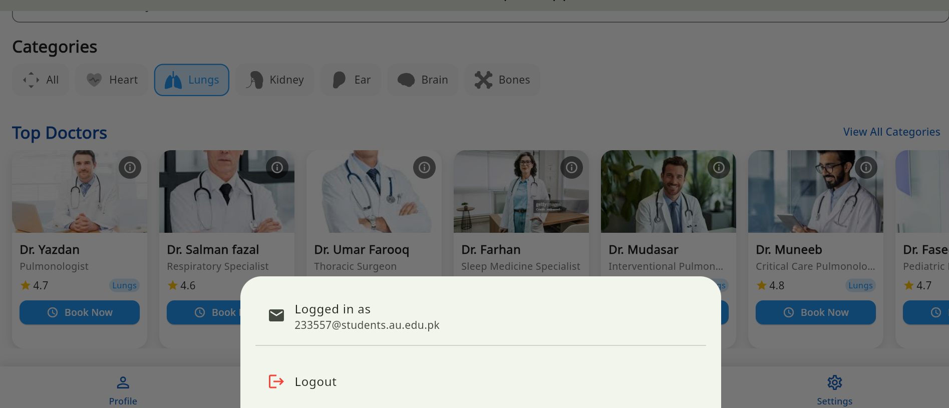
Logout option in menu

Slide 10
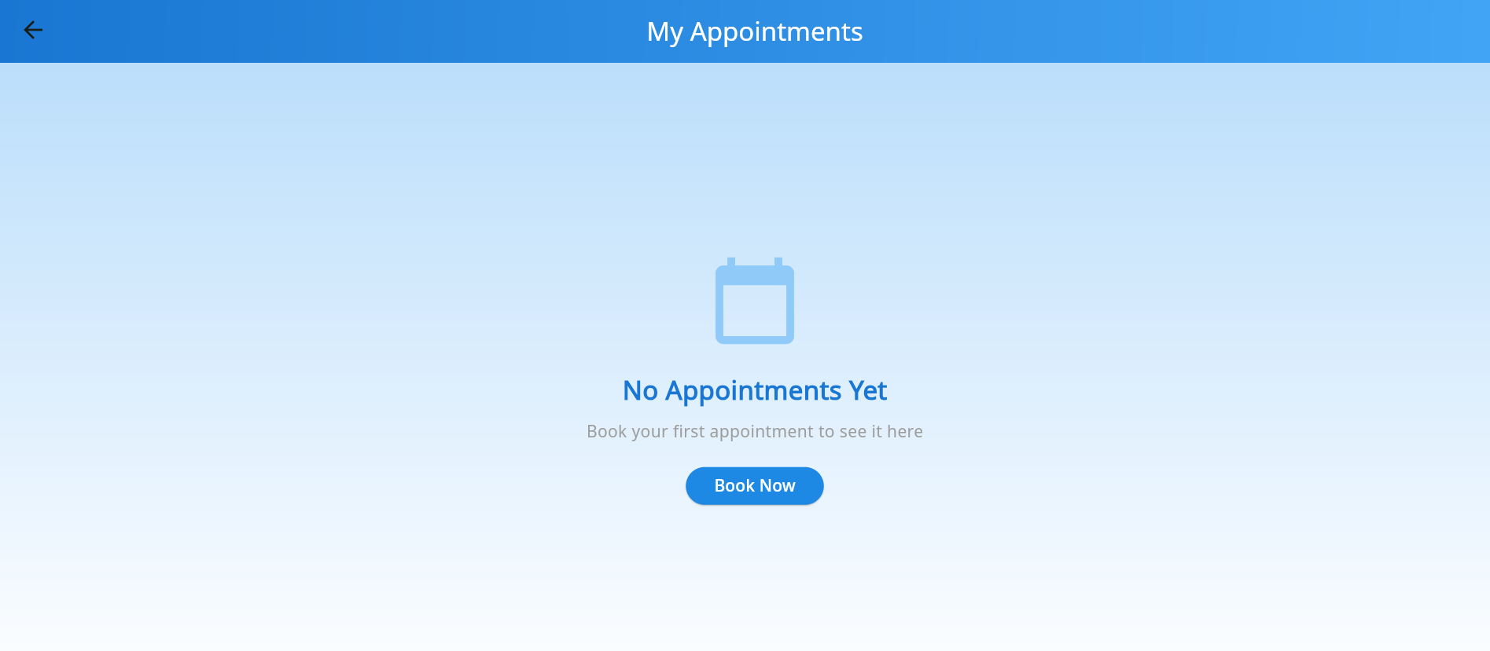
User Appointment Screen

Slide 11
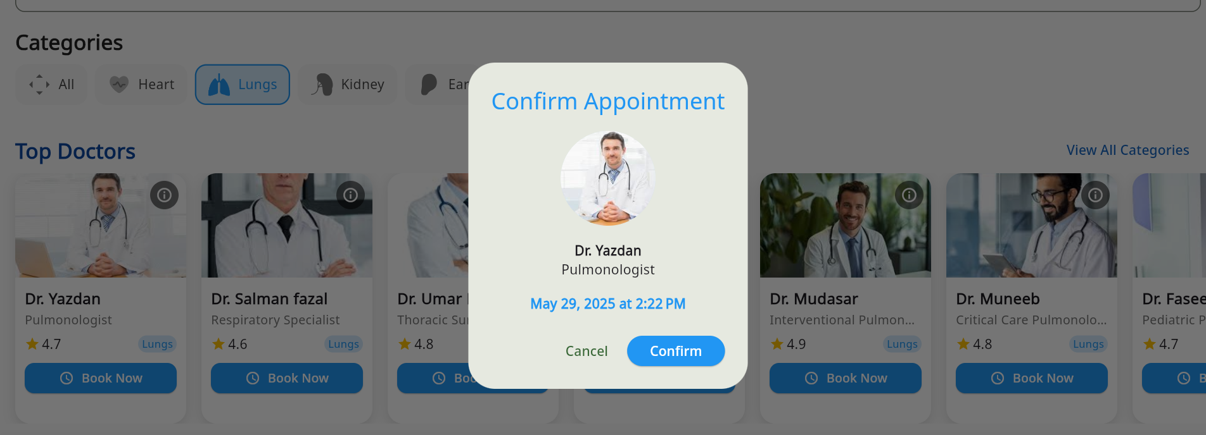
Appointment screen

Slide 12
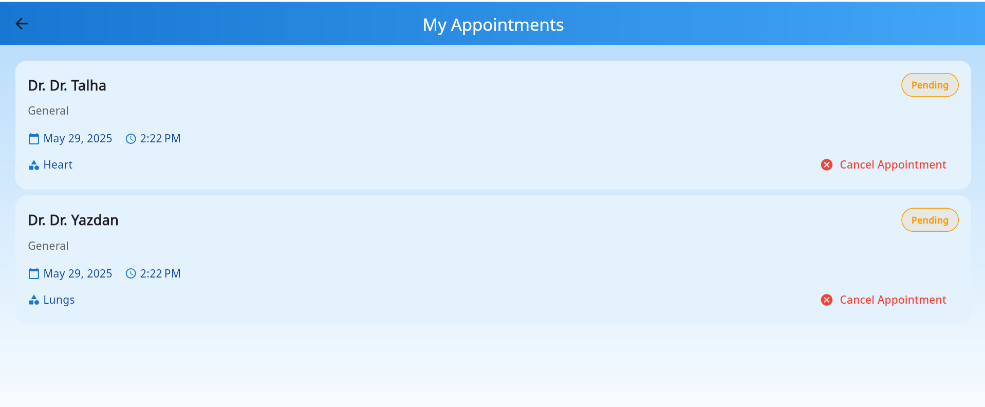
User appointments screen

Slide 13
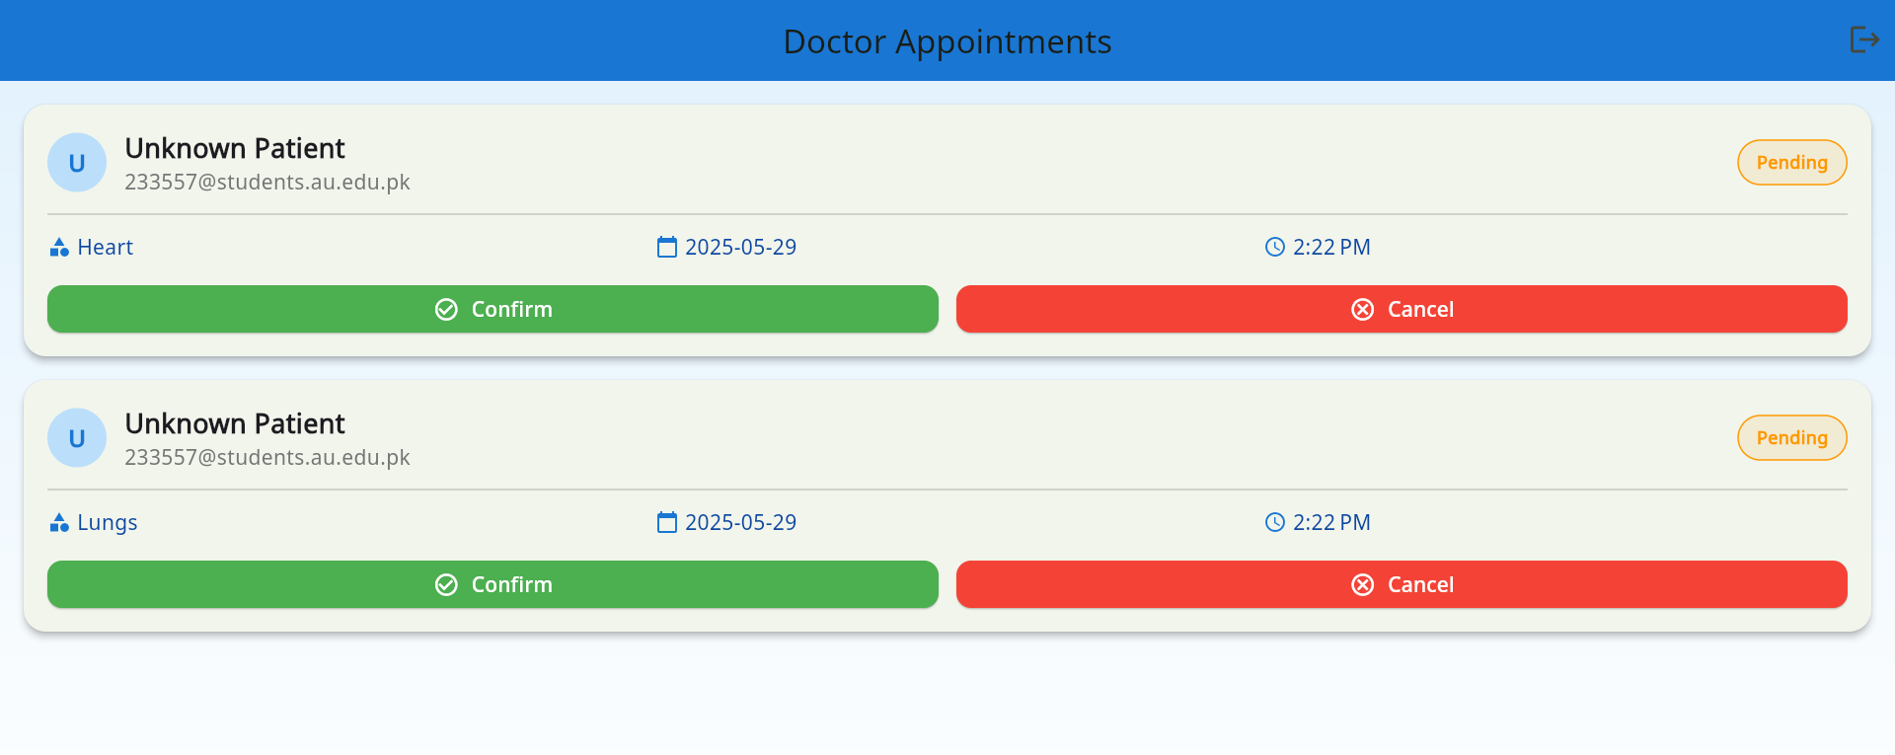
Doctor Appointment screen in which they confirm or cancel the appointment

Slide 14
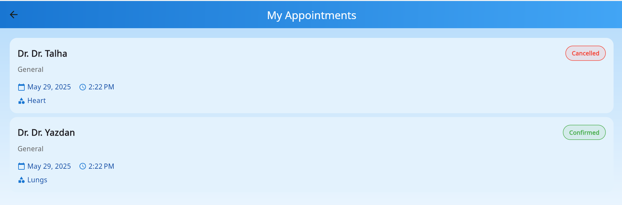
After confirm and cancel the user appointment by doctor now user appoimner screen

Slide 15
Any Question…?

Slide 16
Thank You…..!

